Slide 1
Excel Basics
CIS 300: Computer Information Systems
Professor Matt Thatcher

Slide 2
Start Tegrity!

Slide 3
Reminders
Since Last Class Did You...?
  Read through BB materials!!
    https://blackboard.louisville.edu/webapps/login
  Purchase the course textbook (MIS, 6th Edition by Effy Oz)
  Play with Tegrity Classes
    BB > Tegrity Classes - give it a try!
  Complete Lab 1 (Student Information Survey)
    BB > Tests
    Due: Fri, Jan 15 by 9:00pm
  Form teams to complete the Homework Assignments
    Assignments may be turned in as Office 2007 or 2003 format!
  Check email and BB announcements frequently
    BB > Announcements

Slide 4
Last Class
What is CIS 300 about?
  Learn how to build and use IS to solve business problems
What is a system?
  A set of components that work together to achieve a goal
  Inputs > Process > Outputs
What is an IS? A system that:
  Organizes, collects, and stores data (input and storage)
  Analyzes and manipulates the data (process)
  Generates information (output) used to solve problems and make decisions
  Examples? Amazon.com, Kroger's, Casinos, etc.
What are some common types of IS and IT?
  TPS, FAIS, ERP, CRM, SCM (we will dive into later)
  Databases, data warehouses, decision support systems, expert systems, collaborative systems, telecommunications

Slide 5
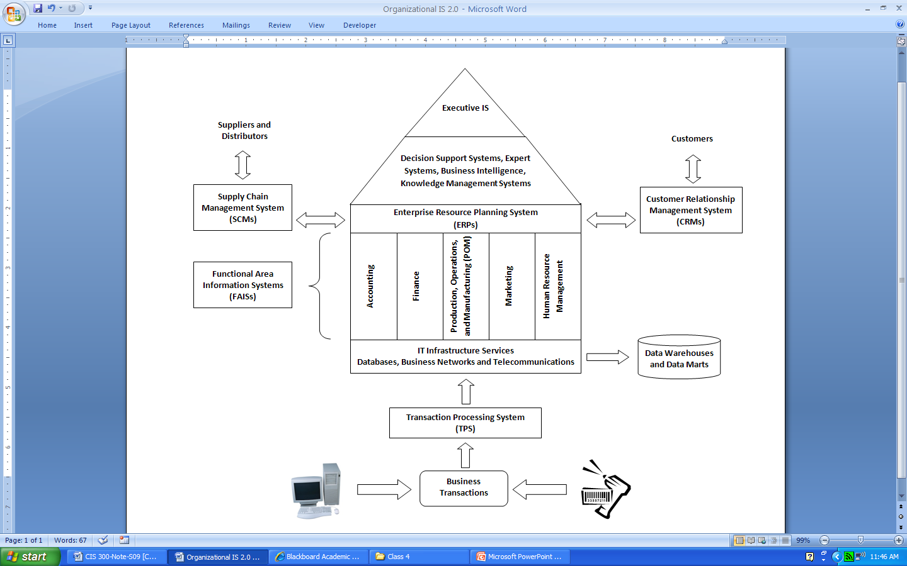
Last Class
Think about the organizational system
Think about organizational sub-systems
Where does CIS fit?
  How to build and use IS to support the business enterprise and coordinate the company’s subsystems
  Requires knowledge of technology, business, and people

Slide 6
Today’s Reference Materials
This slide presentation
  BB > Course Documents > Course Slides
Additional Excel References
  Excel Bible 2007 (see schedule for chapter references)
  BB > Course Documents > Excel
    A whole series of MS Excel 2007 On-Line Tutorials (video- and picture-based)
    These are a very good reference for the basic features and functions
  And others – just search the web or www.youtube.com for “Excel 2007 tutorials”

Slide 7
Introduction to MS Excel 2007

Slide 8
What is Excel?
Electronic spreadsheet used to enter, organize, manipulate, and graph numeric data (and text)
Excel is widely used by people to solve many business problems
  Budgets (Accounting)
  Cash flow projections, personal finance (Finance)
  Sales reports (Marketing)
  Employee benefits (Human Resource Management)
  Scheduling (Production and Operations Management)

Slide 9
Why Learn to Use Excel?
Good working knowledge is required in every business function
Great summer jobs on basis of expertise with Excel
An important life skill today
  The key is in the automatic recalculation of formulas entered and the ability to use absolute and relative addresses
  It is an electronic piece of paper with built-in pencil, eraser, and calculator

Slide 10
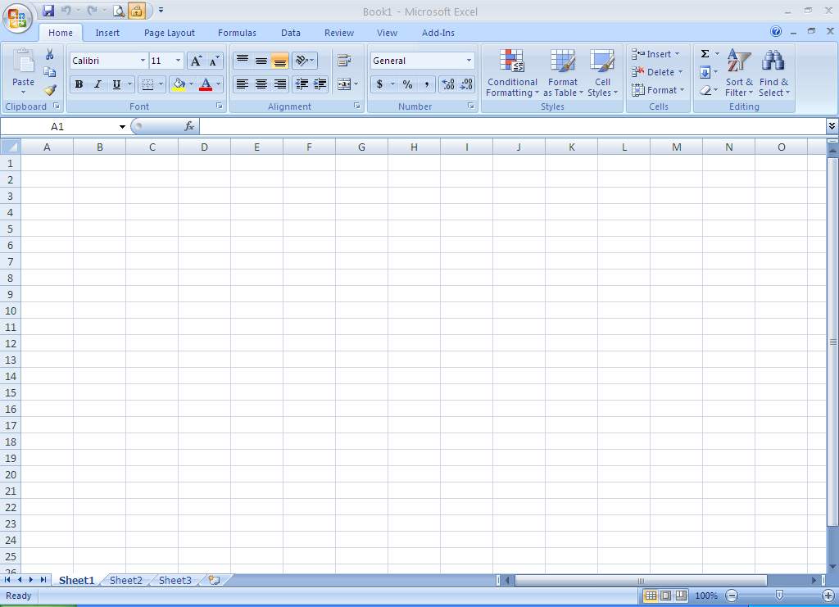
Quick Access Toolbar
Context Tabs
Formula Bar
Column Headings
Office
Button
Ribbon
Name Box
Group of Commands
Active Cell
All Button
Dialog Launcher
(Opens to a Dialog Box)
Row Headings
Vertical Scrollbar
Horizontal Scrollbar
Sheet Tab Scroll Buttons
Sheet Tabs
Insert New Worksheet Button
Zoom Controls

Slide 11
Tour of the Excel 2007 Interface
Starting Excel
  Start menu > All Programs > Microsoft Office > Microsoft Office Excel 2007
Layout
  Excel arranges data in workbooks containing worksheets containing rows (e.g., row 1), columns (e.g., column A), and cells (e.g., cell A1)
    Think of a workbook as a notebook and worksheets as pages in a notebook
    16,384 columns by 1,048,576 rows (Excel 2003 was only 256 by 65,365) – last cell = XFD1048576
    Cells contain: numeric values, text, formulas, and functions
      Can delete, move, copy, edit, format, and enter data and formulas

Slide 12
Other Components of the Excel Interface
Name Box (upper left corner of worksheet)
  Contains the name of the selected cell or range of cells
  By default, names are based on the column and row headings (e.g., B3) but you can give a cell or cell range a different name
  Can be used to take you to a specific cell or cell range
All button (located right below the Name Box)
  Selects the entire worksheet
Cell Selector (heavy border = active cell)
  Shows you the cell that is active
Formula Bar (below the Ribbon)
  Displays the actual contents of the active cell. If a formula or function is in the active cell then it will be displayed in the formula bar while the final calculated value will be displayed in the cell

Slide 13
Other Components of the Excel Interface
Sheet Tabs
  Name of the active sheet is bolded
Sheet Tab Scroll Buttons
  Navigate through the available sheets
Insert Worksheet button
  Shortcut for adding a new worksheet to your workbook
Zoom Control
  Allows you to adjust the display size of the worksheet
  This is actually pretty cool - give it a try!

Slide 14
The Excel Ribbon
(Replaces the Old Menu System)
There are three main parts to the Ribbon
  Contenxt Tabs sit across the top of the Ribbon. Each tab represents an activity (or context) area. Click on a tab to access that context ribbon.
  Groups are sets of related commands displayed together on tabs. Groups pull together all the commands you're likely to need for a type of task.
  Commands are arranged in groups. A command can be a button, a menu, or a box where you enter information.
The Ribbon will adapt depending on what you're working on, to show you the commands you're likely to need for that task.
  For example, if you're working with a chart in Excel, the Ribbon will show the commands you need for working with charts. Otherwise, those commands aren't visible.

Slide 15
Excel Ribbons
(Home Ribbon)
Contains the most commonly use commands
Important Groups
  Clipboard (Cut, Paste, Paste Special)
  Font (Cell Formatting)
  Alignment (Cell Formatting)
  Number (Cell Formatting)
  Styles (Cell Formatting)
  Cells (Insert Cells, Delete Cells)
  Editing (allows you to sort and summarize data)

Slide 16
Excel Ribbons
(Insert Ribbon)
Lists different objects that you can add to your worksheet
Groups
  Tables
  Illustrations
  Charts (graphical representation of numbers)
  Links (create a link to a web page, an email, another cell within an Excel worksheet, or another document)
  Text

Slide 17
Excel Ribbons
(Page Layout Ribbon)
Controls how the overall worksheet will be printed
  This is important but will not be a focus of this class since you turn everything in electronically

Slide 18
Excel Ribbons
(Formulas Ribbon)
Provides commands for working with formulas and functions
  Function Library (find and insert prebuilt functions)
  Defined Names (name cell ranges and Name Manager)
  Formula Auditing (check and debug formulas and functions in your worksheet)
  Calculation (make sure Calculation Options is set to Automatic)

Slide 19
Excel Ribbons
(Data Ribbon)
Provides tools for working with data
Important Groups
  Sort & Filter
  Data Tools (especially What-If Analysis)

Slide 20
Excel Ribbons
(Review Ribbon)
Collaborative tools often used when working with other people on the workbook
Groups
  Proofing
  Comments (sort of like electronic sticky notes)
  Changes
    Track Changes (you can track changes to a worksheet like you can in MS Word)
    Protect Sheet

Slide 21
Excel Ribbons
(View Ribbon)
Controls how the overall worksheet will be viewed on screen

Slide 22
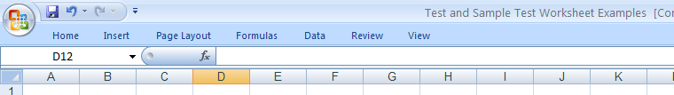
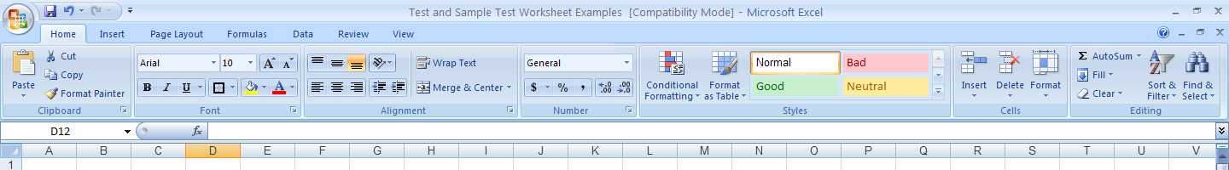
Excel Ribbons
(Hiding and Unhiding)
What if you want the Ribbons to disappear so that you have more space on the sheet?
  Double-click on a context tab (then single click a tab to see the ribbon)
How do you restore the Ribbon?
  Double-click on a context tab again

Slide 23

Additional Features
The new Ribbon applications (e.g., Excel2007) includes two additional features that will help you get your work done quickly and easily.
  Microsoft Office Button
    Has replaced the File menu
    Basic commands to Open, Save, and Print your documents and to set program options, edit file properties, exit Excel, and more.
  Quick Access Toolbar
    Sits above the Ribbon
    Contains commonly used commands
    By default, the Quick Access Toolbar contains the Save, Undo, and Repeat (or Redo) commands, but you can customize it with whatever commands you want.

Slide 24

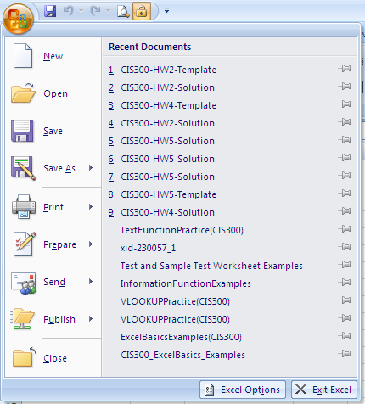
Microsoft Office Button

Slide 25
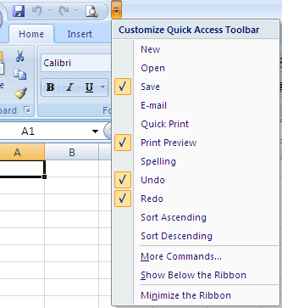
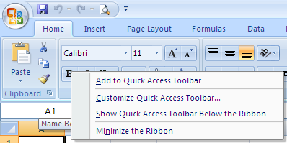
Quick Access Toolbar
(Customizing)
Option 1
Option 2
  Right-click any command (e.g., Bold command)
  Click Add to Quick Access Toolbar

Slide 26
Quick Access Toolbar
(Customizing)
Resetting the Quick Access Toolbar
  More Commands > Reset

Slide 27
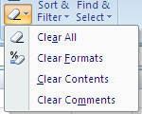
Data Entry
(Text)
Entering Text
  Click on cell > type text > press Enter (or “check mark” in formula bar)
  When you press Enter > cell selector moves down one row
  Text is left-justified
  You can adjust column widths to accommodate long entries by double-clicking on the Column heading right border
  To cancel out of cell without keeping changes > press esc (or “X” in formula bar)
Delete entry
  Click cell > press Delete
  Click cell > Home tab > Editing group > Clear icon
Edit entry
  Click cell > re-enter text
  Double-click cell > edit in the Active Cell
  Click cell > edit in Formula Bar
If you are in a cell click in the middle of some text
  Ctrl + Delete deletes everything to the right of the insertion point

Slide 28
Data Entry
(Numbers)
Entering Numbers
  Click on cell > enter number (do not need $ or commas, you can format the numbers later) > press Enter
  However, if you do enter numbers with $ or commas or % Excel is smart enough to figure out the formatting
  Numbers are displayed right-aligned in cells

Slide 29
Working With Cells and Ranges
Cell Range addresses
  Examples of ranges: C24 or A1:B1 or A1:A100 or A1:XFD1048576 (all cells in a worksheet)
Select a contiguous Cell Range (2 or more cells)
  Click on a cell and drag
  Click on a cell > press Shift key and click on last cell in range
  Range reference: A1:B7
Select noncontiguous Ranges
  Select cell or contiguous range > press Ctrl while you select other ranges
  Range reference: A1:B7,C5:C8,D4
Select Entire Sheet
  Click on All Button in the upper-left corner of sheet (right below the Name Box)

Slide 30
Working With Cells and Ranges
Select Entire Row or Column
  Click on the row (column) heading
Select Multi-sheet Ranges
  Active Sheet > select range B3:F3 > press Ctl and click on other sheet tabs (makes a group selection – see the Title Bar) > Home context tab > Font group > Fill Color (yellow) > press esc (to kill group) > Now take a look at cells B3:F3 on all sheets that you selected
Copy Cells
  Select cells > Home context tab > Copy > select destination cell > Home context tab > Paste
  Select cells > Ctrl + C > select destination cell > Ctrl + V
  Click cell > move cell to border until pointer turns into cross with 4 arrows > click Ctrl and drag cell to destination

Slide 31
Working With Cells and Ranges
Copying using the Fill Handle
  Select cell to copy > click on the black box in the lower right corner of the active cell and drag the handle to copy over or copy down (look through the Auto Fills option icon that pops up when you use the Fill Handle )
    Try Fill Handle with cell that has text of “January” (or even try with just “Jan”)
    Select 2 cells (cell 1 has number 1, cell 2 has number 2) > click and drag the Fill Handle (it tries to figure out patterns)
    Select 2 cells (cell 1 has number 2, cell 2 has number 4) > click and drag the Fill Handle
Inserting Copied Cells
  Copy a range of cells > select destination > Home context tab > Insert (in the cells group) > Insert Cells…
Move Cells
  Select cells > Home context tab > Cut > select destination cell > Home context tab > Paste
  Select cells > Ctrl + X > select destination cell > Ctrl + V
  Click cell > move cell to border until pointer turns into cross with 4 arrows > click and drag cell to destination

Slide 32
Working With Cells and Ranges
Change Row Height and Column Width
  Move mouse to right border of Column Heading (or bottom border of Row Heading) > mouse pointer turns to a different cross > click and drag border to desired size
  A ScreenTip displays the column width as you drag
AutoFit cells in a column
  Move mouse to right border of Column Heading > mouse pointer turns to a different cross > Double-Click the border
  Select column > Home context tab > Cells group > Format > AutoFit Column Width

Slide 33
Working with Sheets
Activate Sheet
  Click on Sheet tab at the bottom of the workbook
  Ctrl + PgUp (activates previous worksheet)
  Ctrl + PgDn (activates next worksheet)
  Right-click on Sheet Tab Scroll Buttons at the bottom left of the workbook shows a list of all worksheets in the workbook
Insert Sheet
  Click on the Insert Worksheet button (the last sheet tab at the bottom)
  Right-click on Sheet tab > Insert > Worksheet
  Home tab > Cells group > Insert > Insert Sheet
Rename Sheet
  Double-click Sheet tab > type new name
  Right-click on sheet tab > Rename
  Must be <= 31 letters, numbers, spaces (no characters like !, ?, *)

Slide 34
Working with Sheets
Tab Color
  Right-click Sheet tab > Tab Color > choose color
Rearrange Sheets
  Click and drag Sheet tab
Copy Sheets
  Click on Sheet tab > press Ctrl and drag tab to its desired location (then rename it)
  Click on the All button (upper-left corner of the sheet you want to copy) > Ctrl + C > Click on destination Sheet tab > Ctrl + V
Delete Sheets
  Home tab > Cells group > Delete > Delete Sheet
  Right-click on Sheet tab > Delete

Slide 35
Working with Sheets
Insert Rows and Columns
  Select row (by clicking on a row number) > Home tab > Cells group > Insert > Insert Sheet Rows
  Select column (by clicking on a column letter) > Home tab > Cells group > Insert > Insert Sheet Columns
  Select row or column > Right-click > Insert
  Same thing to insert a multiple columns (rows) at one time
Delete Rows and Columns
  Select row > Home tab > Cells group > Delete > Delete Rows
  Select row > Right-click > Delete
Selecting Multi-Sheet Ranges
  Select range (e.g., B3:D3) > press Ctrl while clicking any tabs that you want to select (makes a “group selection”) > Home context tab > Bold > Fill Color yellow > press esc (to deactivate the “group selection”)

Slide 36
Defining Names in Worksheets
Defined cell names:
  (1) cannot contain spaces,
  (2) must start with a letter,
  (3) can contain numbers, and
  (4) cannot look like a cell reference (e.g., C4)
How to define a cell (or cell range) name
  Select cell to name > Formulas tab > Defined Names group > Define Name > Define Name…
  Name Box
    Shows the name of the defined cell and provides a drop-down box for easy navigation to named cells
    You can define cell names directly from the Name Box: Click on cell > click on Name Box > enter cell name > click Enter
  You can also name ranges of cells
Redefining, Changing, and Deleting Names
  Formulas tab > Defined Names group > Define Name > Define Name

Slide 37
Defining Names in Worksheets
If you define names for cell references after creating one or more formulas that use those cell references, you can update those to use a name. To apply, do the following:
  Select only the cells that contain the formulas desired, or select a blank cell to update all worksheet formulas
  Formulas tab > Defined Names group > Define Name > Apply Names… > click on the range name > click OK

Slide 38
Adding Comments to Cells
Comments
  Documentation that helps explain certain cells in a worksheet
  Especially helpful when you are collaborating with one or more people
Adding Comments
  Select Cell > Review tab > Comments group > New Comment > enter comment > click anywhere on sheet
  Shift + F2
  Small red triangle in upper-right corner of cell indicates a comment is attached to the cell
  Comment appears when you hover over the cell
The comment box can be resized by click and drag
Deleting or Editing Comments
  Right-Click on cell > Delete Comment (or Edit Comment)
  Select Cell > Review tab > Comment group (use these commands)

Slide 39
Formatting Worksheets
Format controls how entries are displayed in a cell (position in the cell, text font, color, patterns, borders, number format, etc.)
Home tab
  Font group: pretty self-explanatory or use Ctrl + B (bold), Ctrl + I (italics), Ctrl + U (underline)
  Alignment group: Allows you to change the vertical and horizontal placement and orientation of entries in a cell
  Number group: Currency Style, Percent Style, Comma Style, Increase Decimal, Decrease Decimal
  Play with the other groups as well
Indenting Entries
  Select range > Home tab > Alignment group > click Increase Indent icon
Centering Across a Selection (Merging Cells)
  Select cells to merge and center > Home tab > Alignment group > press the Merge and Center icon
  Careful using this feature because the merge could delete data!
  Use the same methods to Unmerge the cells

Slide 40
Formatting Worksheets
Format Painter
  Use Format Painter to apply a format of one cell to another cell (or set of cells)
  To apply a format to one cell
    Select the cell that has the format you want to copy > Home tab > Clipboard group > single-click Format Painter > click on the destination cell to apply the format
  To apply a format to multiple cells
    Select the cell that has the format you want to copy > Home tab > Clipboard group > Double-click Format Painter > click on the destination cells to apply the format > click esc or single-click Format Painter to exit the mode

Slide 41
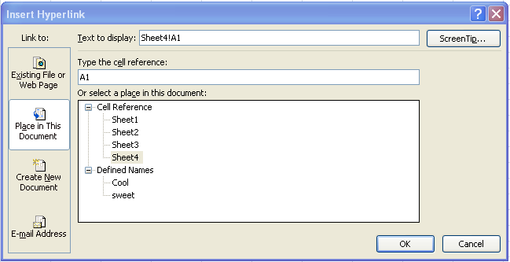
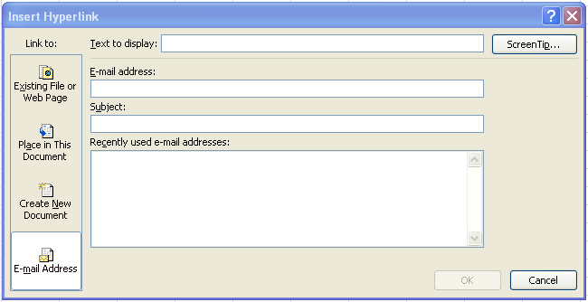
Hyperlink
Insert tab > Links group > Hyperlink
  can link to an Existing File or Web Page
    Just enter URL in the Address text box
  Can link to a Place in this Document
  Can link to an Email Address

Slide 42
Hyperlink
To edit or remove the hyperlink
  Right-click on the cell with the link > Edit Hyperlink
  Right-click on the cell with the link > Remove Hyperlink

Slide 43
Key Tips
Keyboard Shortcuts
  As soon as you press the Alt key, you will see little labels, or badges, pop up showing the Key Tips for all the tabs.
  After you press a key to activate a particular tab, the badges showing the Key Tips for the commands on that tab appear
Key Tips are a great way of using keyboard shortcuts, because you have a constant reminder on screen of what keys you need to press. No memorizing is necessary.
If you use a screen reader: Key Tips should be available to your screen reader through a technology known as Microsoft Active Accessibility (MSAA).

Slide 44
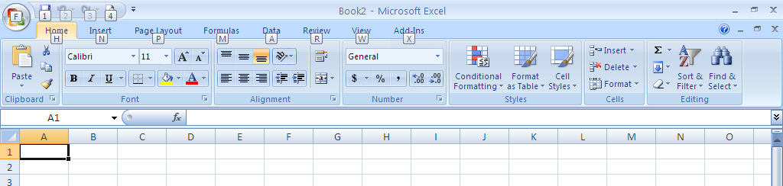
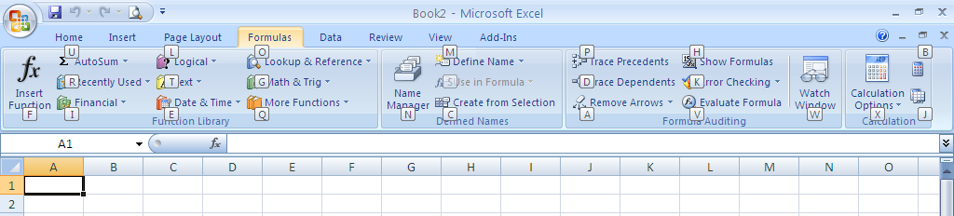
Key Tips
(An Example)
Press Alt key
Press M (on keyboard) – activates the Formulas tab

Slide 45
Getting Help
Help assistance within Excel
  Click or simply press the F1 key
Visit Microsoft Office Online – Excel
Web-based resources
  Blackboard - reference documents located under
  BB > Course Documents > Excel
  Google - use Advanced Search criteria
University of Louisville
  Computer Resource Center - REACH (free tutoring)
Ask your Homework Assignments partner

Slide 46
Features
Analysis ToolPak
  An add-in program that comes with MS Excel
  Must be loaded using the following steps:
    Office Button > Excel Options > Add-ins (in the left pane) > click on the Manage drop-down box > select Excel Add-ins > press Go > make sure that the check boxes for Analysis ToolPak and Solver Add-in are selected (i.e., checked) > click OK
  Where are the programs>
    Data tab > Data Tools and Analysis group

Slide 47
Excel Formulas and Functions

Slide 48
Formulas
Definition
  Are equations that perform calculations on values in an Excel worksheet
  A formula always starts with an equal sign (=)
Make sure that calculations are automatic
  Formulas tab > Formula Auditing group > Calculation > Calculation Options > set to Automatic

Slide 49
Calculations and Operators
Calculation operators
  Arithmetic (+ - * / % ^)
  Comparison (= > < >= <= <>)
  Text concatenation (&)
  Reference (: ,)
Operator precedence
  Arithmetic operations performed in order [ () % ^ * / + - &) prior to any comparisons (= > < >= <= <>)
  Parenthesis used to change the order of evaluation
A good reference for order of operations
  http://office.microsoft.com/en-us/excel/HP051986971033.aspx?pid=CH010004901033

Slide 50
Evaluating Formulas
Evaluate anything in parentheses first
  Evaluate the arithmetic operators in the following order
  (Pretty Please Excuse My Dear Aunt Sally)
  Parentheses
  Percent
  Exponentiation
  Multiplication or Division
  Addition or Subtraction
In case of a tie, evaluate the operators from left to right
Write down your answer for the following formula
=23+((5+9)*3)/7-5.
=24

Slide 51
Evaluating Formulas
=23+((5+9)*3)/7-5
This is how it would be evaluated. The computer would:
  Add 5+9 to get 14
  Multiply the 14 times 3, which is 42
  Divide the 42 by 7 to get 6
  Add 23 and 6 to get 29
  Subtract the 5 from 29
  To get 24 as a final answer
Confirm this using Formula Auditing

Slide 52
Other Examples
Order of Operations
  Parentheses ()
  Exponentiation ^
  Multiplication and Division * /
  Addition and Subtraction + -
Examples
  Evaluate: =3+2^3*4/16-6
    -1
  Evaluate: =16*4/2^4+12/(6-2^2)
    10
  Make sure you can do this with numbers or cell references
    Practicing is simple – just make up problems and enter them into MS Excel!

Slide 53
Cell References
Absolute
  In a formula, it is the exact address of a cell, regardless of the position of the cell that contains the formula
  If you copy the formula, the reference does not change
  Takes the form $A$1 ($ denotes absolute reference)
Relative
  In a formula, address of a cell based on the relative position of the cell that contains the formula and the cell being referred to
  If you copy the formula, the reference adjusts
  Takes the form A1

Slide 54
Cell References
Mixed
  Absolute column and relative row takes the form $A1
  Relative column and absolute row takes the form A$1
  Can use both of these in the same formula
Absolutely the Last Article You Need To Read About Cell References in Excel
  http://www.peachpit.com/articles/article.asp?p=361414&seqNum=1&rl=1

Slide 55
Cell References
What happens to a cell reference when you copy a formula from Cell A1 to Cell C3?
Old | Reference (Description) | New
=$B$1 | Absolute column and absolute row | =$B$1
=B$1 | Relative column and absolute row | =D$1
=$B1 | Absolute column and relative row | =$B3
=B1 | Relative column and relative row | =D3

Slide 56
Cell References
Can use F4 key to cycle through the cell reference options (absolute, relative, mixed)
How do you copy a formula with relative references without changing the references?
  Click on the cell with the formula > go to the Formula Bar > copy the formula > select the destination cell > paste the formula (the references will not change since the formula was copied as text)

Slide 57
Referencing a Cell on Another Worksheet
How do you reference a cell on another worksheet?
  Sheetname!cellreference (Sheet1!E22)
    the sheet name, an exclamation point, and the cell reference
  ‘Sheet Name’!cellreference (‘My Sheet’!E22 )
    if the sheet name contains non-alphabetic characters (such as a space) you must enclose the sheet name in single quotation marks
  You will see this in Lab 2
  This is easiest to do by pointing and clicking
=Sheet1!A1+’My Sheet’!B2

Slide 58
Functions
Click the cell in which you want to enter formula
If you are “trapped” in another cell, press Esc key
To begin a formula with a function
  Formulas tab > Function Library group > select the category and function you want to use (or click Insert Function to select from a dialog box) > Enter criteria in the Function Arguments dialog box
Better yet, just type the function into the Formula Bar

Slide 59
Errors
#####
  Typically occurs when column not wide enough
#VALUE!
  Occurs when wrong type of argument or operand is used
  To resolve, click the cell that displays the error, click the button that appears, then click Trace Error if it appears
  Review the possible causes and solutions which results
#DIV/0!
  Occurs when a number is divided by zero (0)

Slide 60
Errors
#NAME?
  Occurs when Excel doesn’t recognize the text in a formula
  Often caused by a misspelled name or missing quote mark
  To resolve, click the cell that displays the error, click the button that appears, then click Trace Error if it appears
  Review the possible causes and solutions which results
#N/A
  Occurs when a value is not available to a function or formula - use Trace Error to resolve, if available
  Often results from an inappropriate argument value in an HLOOKUP, LOOKUP, MATCH, VLOOKUP function

Slide 61
Errors
# REF!
  Occurs when a cell reference is not valid
  Use Trace Error to resolve, if available
# NUM!
  Occurs with invalid numeric values in a function or formula
  Use Trace Error to resolve, if available
# NULL!
  Occurs when you specify an intersection of two areas that do not intersect
  Use Trace Error to resolve, if available

Slide 62
Basic Functions
SUM
MIN
MAX
AVERAGE
COUNT
COUNTA
IF
AND
OR
NOT

Slide 63
The SUM Function
Adds all the numbers in a range of cells
Syntax
SUM(range)
Remarks
If an argument is a cell range or reference, only numbers in that range or reference are counted.
  Empty cells, logical values, text, or error values in the range or reference are ignored

Slide 64
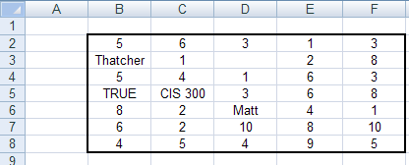
The SUM Function
(Examples)
=SUM(F2:F4)
14

Slide 65
The SUM Function
(Examples)
=SUM(D2:F2,F8,B5)
12

Slide 66
The SUM Function
(Examples)
=SUM(B2:B5)
10

Slide 67
The SUM Function
(Examples)
=SUM(D2:D5)
7

Slide 68
The SUM Function
(Examples)
Note: The range B2:F8 has been named “Thatcher”
=SUM(Thatcher)
143

Slide 69
The MAX Function
Returns the largest value in a set of values
Syntax
MAX(range)
Remarks
If an argument is a cell range or reference, only numbers in that range or reference are used.
  Empty cells, logical values, or text in the range or reference are ignored
  If the arguments contain no numbers, MAX returns 0 (zero)

Slide 70
The MAX Function
(Examples)
=MAX(F2:F4)
8

Slide 71
The MAX Function
(Examples)
=MAX(D2:F2,F8,B5)
5

Slide 72
The MAX Function
(Examples)
=MAX(B2:B5)
5

Slide 73
The MAX Function
(Examples)
=MAX(D2:D5)
3

Slide 74
The MAX Function
(Examples)
Note: The range B2:F8 has been named “Thatcher”
=MAX(Thatcher)
10

Slide 75
The MIN Function
Returns the smallest number in a set of values.
Syntax
MIN(range)
Remarks
If an argument is a cell range or reference, only numbers in that range or reference are used.
  Empty cells, logical values, or text in the range or reference are ignored
  If the arguments contain no numbers, MIN returns 0

Slide 76
The MIN Function
(Examples)
=MIN(F2:F4)
3

Slide 77
The MIN Function
(Examples)
=MIN(D2:F2,F8,B5)
1

Slide 78
The MIN Function
(Examples)
=MIN(B2:B5)
5

Slide 79
The MIN Function
(Examples)
=MIN(D2:D5)
1

Slide 80
The MIN Function
(Examples)
Note: The range B2:F8 has been named “Thatcher”
=MIN(Thatcher)
1

Slide 81
The AVERAGE Function
Returns the average (or arithmetic mean) of the arguments
Syntax
AVERAGE(range)
Remarks
If an argument is a cell range or reference, only numbers in that range or reference are used.
  Empty cells, logical values, or text in the range or reference are ignored
  Cells with a value of zero are included

Slide 82
The AVERAGE Function
(Examples)
=AVERAGE(F2:F4)
4.67

Slide 83
The AVERAGE Function
(Examples)
=AVERAGE(D2:F2,F8,B5)
3

Slide 84
The AVERAGE Function
(Examples)
=AVERAGE(B2:B5)
5

Slide 85
The AVERAGE Function
(Examples)
=AVERAGE(D2:D5)
2.33

Slide 86
The AVERAGE Function
(Examples)
Note: The range B2:F8 has been named “Thatcher”
=AVERAGE(Thatcher)
4.77

Slide 87
The COUNT Function
Counts the number of cells in a cell range that contain numbers
Syntax
COUNT(range)
Remarks
If you want to count logical values, text, or error values, use the COUNTA function

Slide 88
The COUNT Function
(Examples)
=COUNT(F2:F4)
3

Slide 89
The COUNT Function
(Examples)
=COUNT(D2:F2,F8,B5)
4

Slide 90
The COUNT Function
(Examples)
=COUNT(B2:B5)
2

Slide 91
The COUNT Function
(Examples)
=COUNT(D2:D5)
3

Slide 92
The COUNT Function
(Examples)
Note: The range B2:F8 has been named “Thatcher”
=COUNT(Thatcher)
30

Slide 93
The COUNTA Function
Counts the number of cells in a cell range that are non-blank
Syntax
COUNTA(range)

Slide 94
The COUNTA Function
(Examples)
=COUNTA(F2:F4)
3

Slide 95
The COUNTA Function
(Examples)
=COUNTA(D2:F2,F8,B5)
5

Slide 96
The COUNTA Function
(Examples)
=COUNTA(B2:B5)
4

Slide 97
The COUNTA Function
(Examples)
=COUNTA(D2:D5)
3

Slide 98
The COUNTA Function
(Examples)
Note: The range B2:F8 has been named “Thatcher”
=COUNTA(Thatcher)
34

Slide 99
Embedded Functions
=SUM(MIN(B2:B8),MAX(F2:F8),AVERAGE(MIN(B2:B8),MAX(F2:F8)))
21
4
10
4
10
7

Slide 100
Formula Auditing
(useful with embedded functions)
Enables a user to graphically display or trace relationships between cells and formulas
Can see formula evaluated in order calculated
Especially useful for Nested IF statements
To invoke:
  Formulas tab > Formula Auditing group > Evaluate Formula
    Click Evaluate to examine the resulting value of the underlined reference
    The result of the evaluation is shown in italics

Slide 101
Displaying/Watching Formulas
To display formulas within a worksheet:
  Formulas tab > Formula Auditing group > Show Formulas
  Press CTRL + ~ to switch between displaying formulas and their values on a worksheet
Watch cells and formulas via Watch Window
  Formulas tab > Formula Auditing group > Watch Window
  Can move Watch Window toolbar around the screen screen
  Allows you to watch a cell change no matter where you are on the sheet

Slide 102
Summary
And those are the basics…

